Slide 1
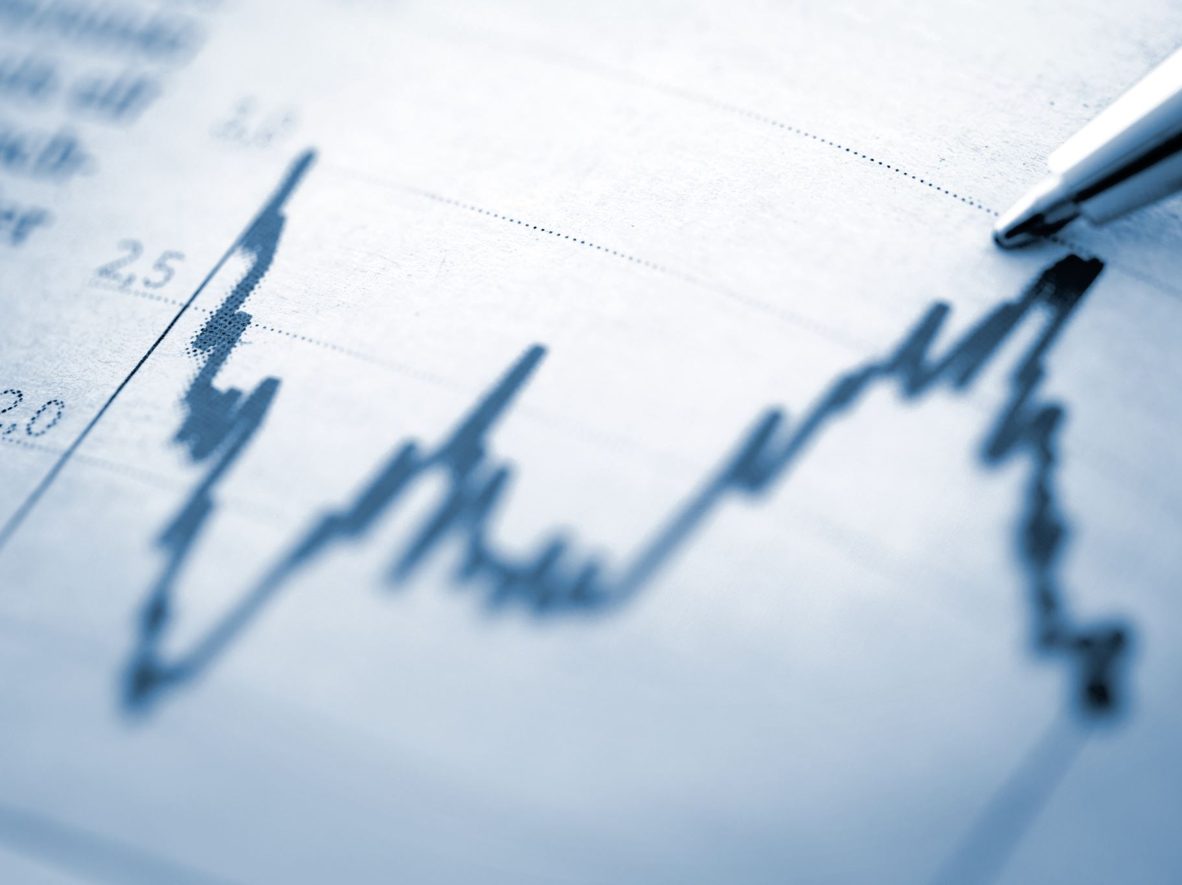
Analyzing Financial Transaction Patterns and Fraud Detection Using Python & Power BI
IT 7123 – Business Intelligence
Team Members: James Cooper · Christopher Davis · Griffin Sykes
Semester: Fall 2025

Slide 2
Abstract / Executive Overview
This project explores how financial transaction patterns can be analyzed to detect fraud using a combined approach of Python-based analytics and Power BI visualization.
We use the PaySim synthetic financial dataset to identify fraudulent behaviors, analyze transaction flows, and uncover trends that support financial risk prevention.
The final deliverables include a Python notebook, a Power BI dashboard, and a comprehensive BI-driven research report.

Slide 3
Problem Statement
Fraudulent financial transactions continue to increase as digital payment systems scale.
Organizations need faster, more accurate ways to identify suspicious behavior and prevent financial loss.
The challenge is understanding how transaction patterns correlate with fraud and how BI tools can support detection and response.

Slide 4
Research Question
Primary Question:
How can transactional patterns be analyzed to detect fraudulent financial behavior and support risk prevention strategies?
Supporting Questions:
Which transaction types carry the highest fraud risk?
What patterns in amount, frequency, or account behavior indicate fraud?
How do account balances change during fraud?
Can machine learning group high-risk users or transactions?

Slide 5
Dataset Overview
Dataset: PaySim1 Synthetic Financial Transaction Dataset
Source: Kaggle
Size: 6.3 million transactions
Key fields:
Transaction type
Amount
Old/New balance (origin/destination)
IsFraud, IsFlaggedFraud
The dataset simulates realistic mobile money transactions and fraud scenarios.

Slide 6
Dataset Schema
Main Columns:
step – Time step (1 hour increments)
type – Transaction category
amount
oldbalanceOrg / newbalanceOrg
oldbalanceDest / newbalanceDest
isFraud – Flag for fraudulent transactions
isFlaggedFraud – Manually flagged anomalies
Schema supports both behavioral and risk-based analysis.

Slide 7
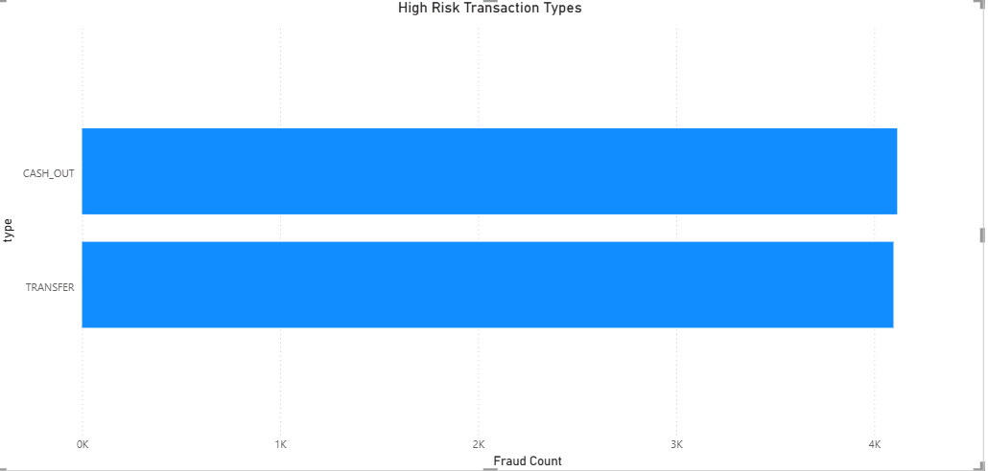
Fraud Types Overview
Most fraud in this dataset occurs during:
TRANSFER transactions
CASH_OUT transactions
Fraudsters commonly move money between accounts and immediately cash out.
Patterns focus on sudden balance changes and unusual transfer flows.

Slide 8
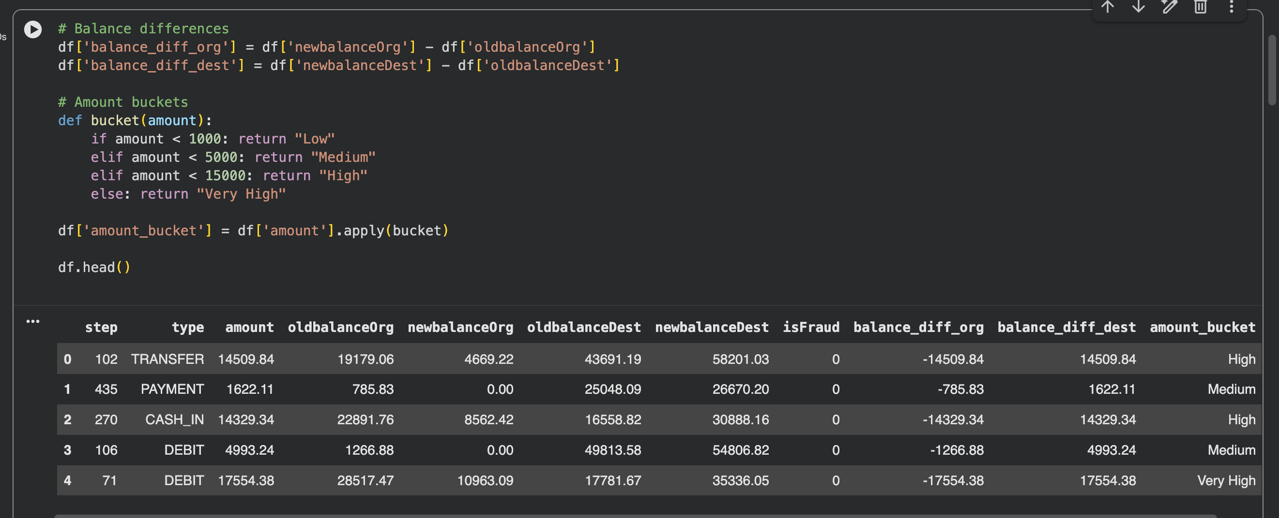
Python Workflow Overview
Load and inspect dataset
Clean and preprocess data
Perform exploratory data analysis
Analyze fraud distribution and patterns
Engineer features for ML
Create clustering or classification models
Export aggregated data to Power BI

Slide 9
Data Cleaning Steps
Handle missing values
Standardize transaction names
Validate numerical columns
Create derived fields (e.g., balance differences)
Remove irrelevant variables
Filter out incomplete or impossible transactions

Slide 10
Exploratory Data Analysis
Explored patterns in:
Transaction type frequencies
Fraud occurrences
Amount distributions
Account balance changes
Daily/hourly fraud trends
Visualized distributions to understand baseline patterns and unusual behaviors.

Slide 11
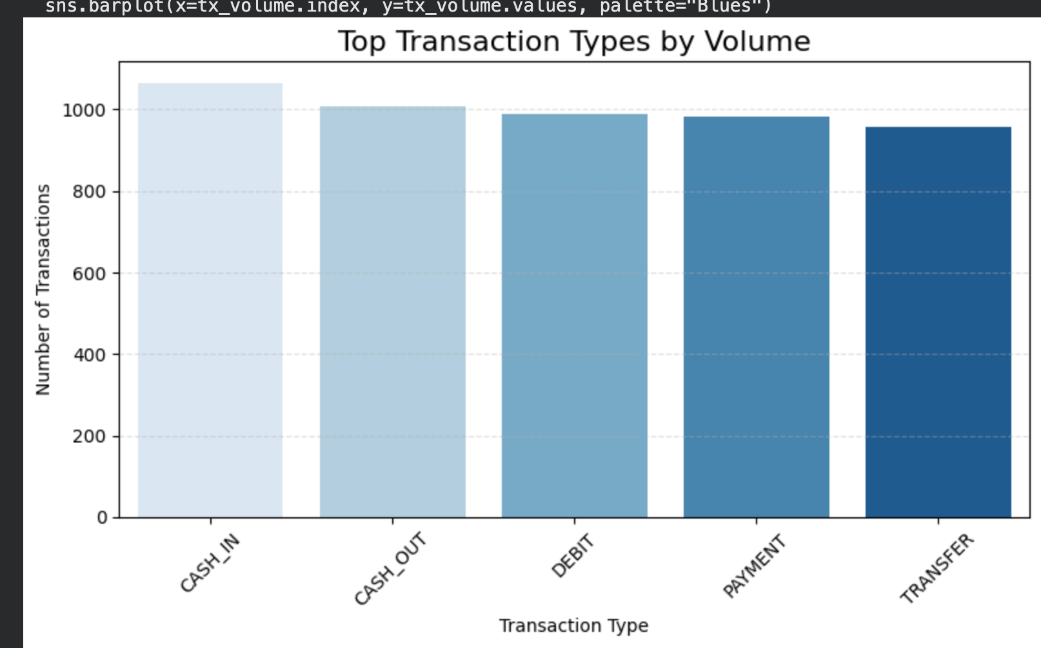
Transaction Type Analysis
Top transaction types by volume:
CASH_OUT
PAYMENT
CASH_IN
TRANSFER
Top transaction types by fraud concentration:
TRANSFER
CASH_OUT

Slide 12
Fraud Rate by Transaction Type
Fraud rate (example pattern):
TRANSFER: Highest fraud rate
CASH_OUT: Second highest
PAYMENT, DEBIT: Very low or zero
Insight: Fraudsters frequently move funds through TRANSFER before cashing out.

Slide 13
Amount Pattern Analysis
Fraudulent transactions typically involve:
Higher-than-average amounts
Sudden spikes in transaction volume
Repetitive high-value transactions in short windows
Often tied to draining account balances quickly.

Slide 14
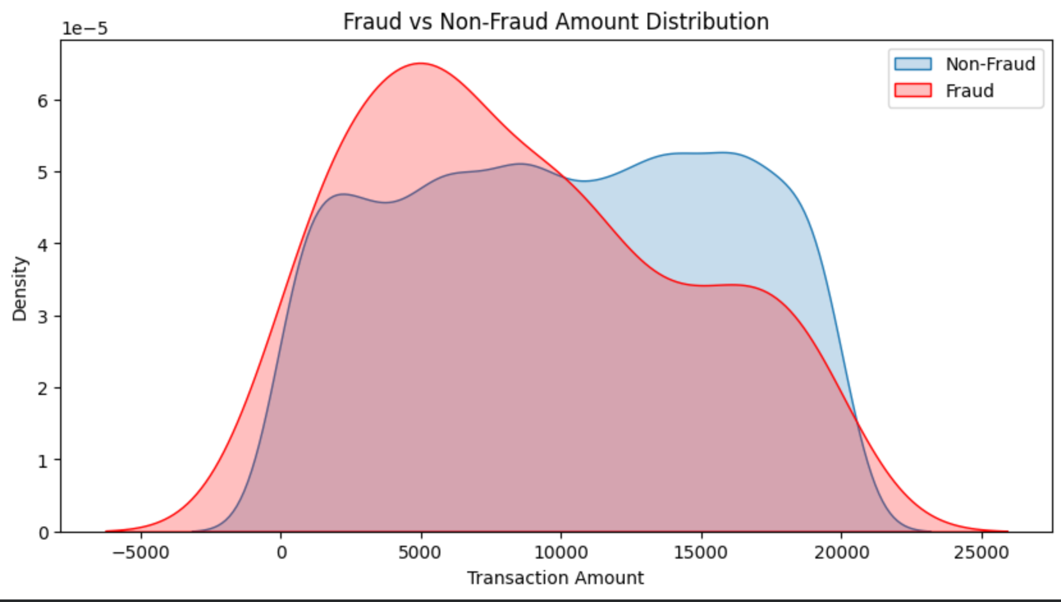
Fraud Amount vs Non Fraud

Slide 15
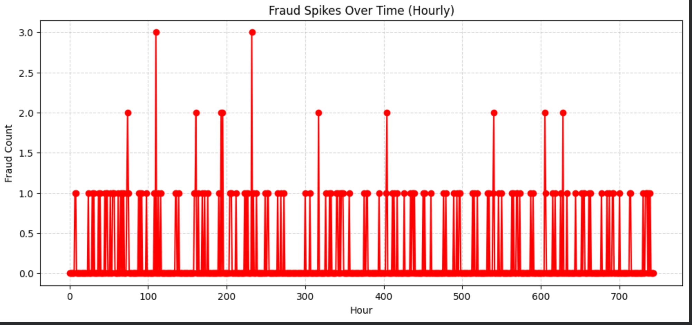
Fraud Spikes Over Time

Slide 16
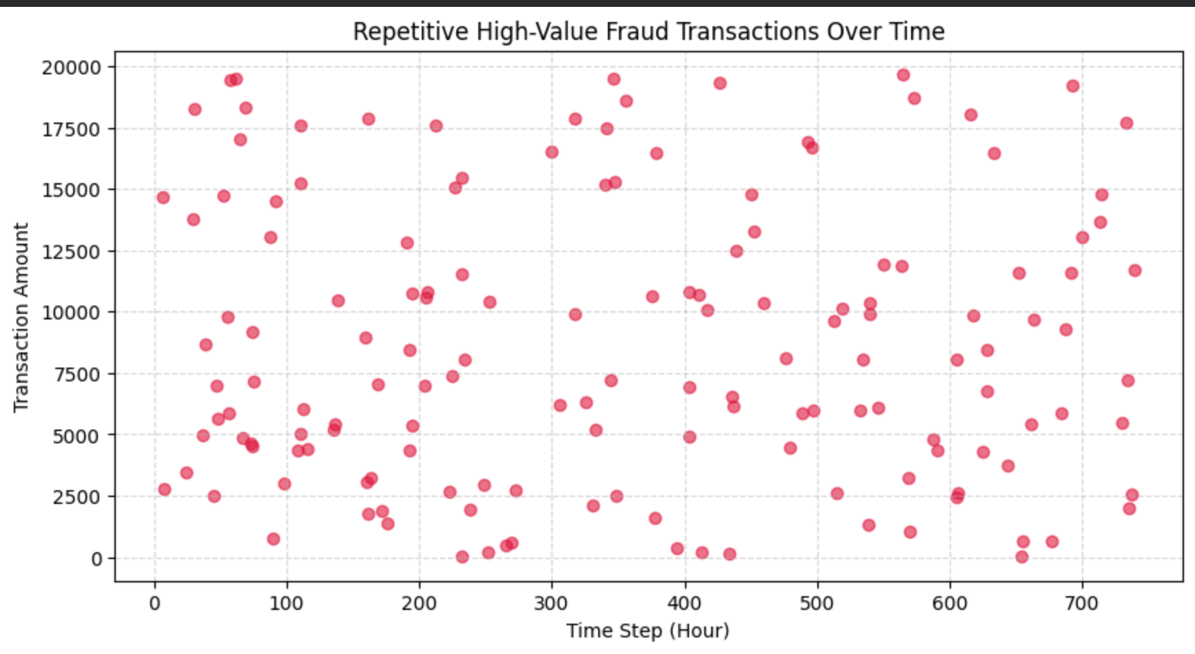
High Value Fraud Transactions Over Time

Slide 17
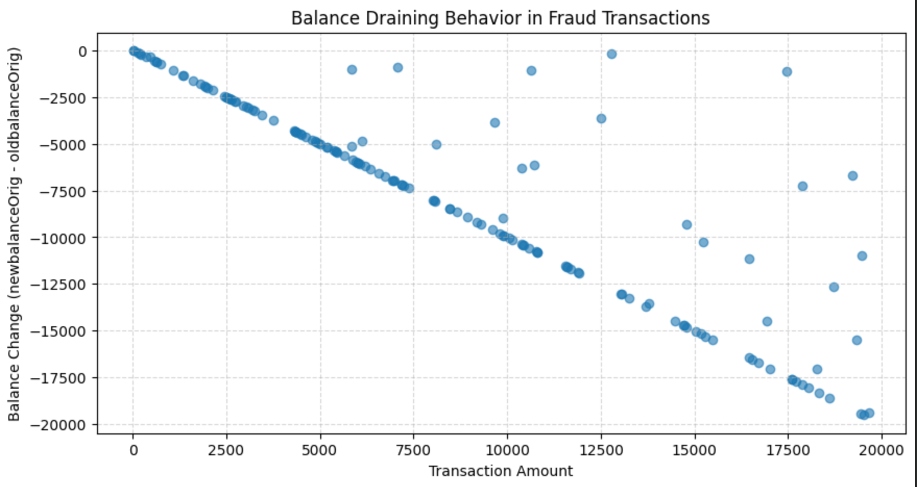
Balance Draining Fraud Transactions

Slide 18
Balance Change Patterns
Fraud patterns seen:
New balance dropping to zero after cash-out
Large transfers from accounts with unusually high balances
Negative or illogical balance differences
These patterns help model suspicious account behavior.

Slide 19
Feature Engineering
Created new fields to improve detection:
balance_diff_org
balance_diff_dest
high_value_flag
is_zero_balance_after
Normalized transaction amounts
These features improved clustering and classification performance.

Slide 20
Clustering Overview
Used clustering to segment transactions/users into behavior groups:
Normal activity
High-value, low-frequency users
High-frequency transactional users
Suspicious spikes or transfer-heavy segments
Helps identify outlier patterns.

Slide 21
Clustering Results
Clusters identified patterns such as:
Accounts repeatedly sending large transfers
Accounts cashing out immediately after receiving funds
Low-activity accounts with sudden large withdrawals
These segments represent red flags in fraud detection.

Slide 22
Classification Overview
Models tested:
Logistic Regression
Random Forest
Gradient Boosting
Goal: Predict whether a transaction is fraudulent based on features.

Slide 23
Classification Model Results
Typical model behavior:
High precision for TRANSFER/CASH_OUT fraud
Random Forest performed best
False positives occurred around high-value legitimate transfers
Overall, model successfully identified fraud patterns in the dataset.

Slide 24
Python Visualizations Summary
Included visuals such as:
Fraud distribution charts
Amount boxplots
Heatmaps
Clustering diagrams
Model accuracy/confusion matrices
These visuals informed Power BI design.

Slide 25
Power BI Workflow Overview
Import processed data
Build star schema or table relationships
Create DAX measures
Develop interactive visuals
Add filters, drilldowns, and user segments
Design dashboard for fraud detection insights

Slide 26
Power BI Data Model
Model includes:
FactTransactions
DimTransactionType
DimAccount
DimDate
Star-schema structure improves filtering and performance.

Slide 27
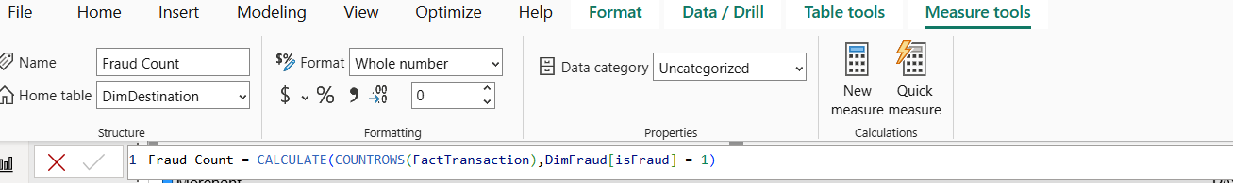
DAX Measures Used
Examples:
Fraud Rate = SUM(isFraud)/COUNTROWS(...)
Avg Transaction Amount
High-Risk Transaction Count
Total Fraud Loss (estimated)
Measures drive calculations and KPIs.

Slide 28
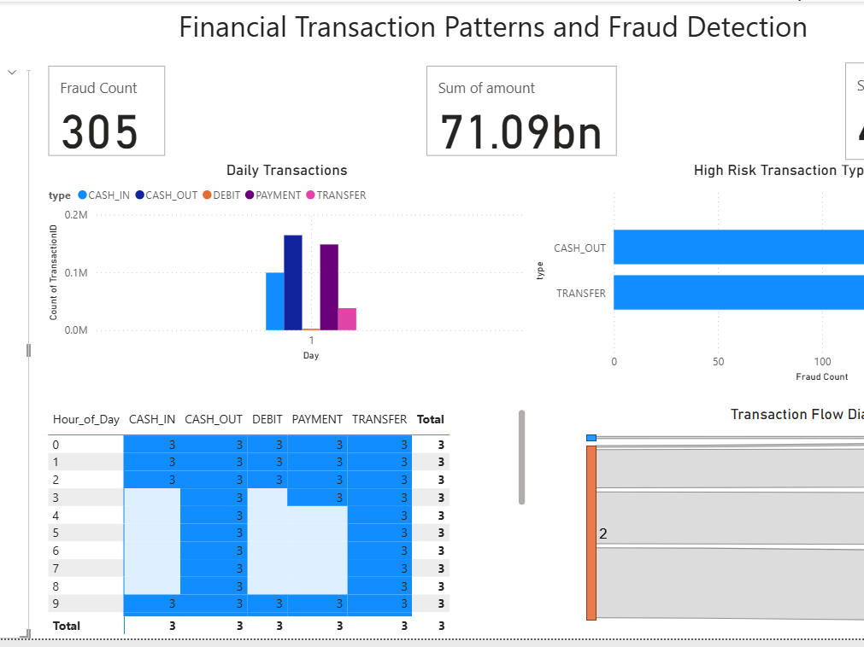
Dashboard Overview
The dashboard includes:
Fraud trends over time
High-risk transaction types
Geographic or account-based fraud hotspots
Transaction flow diagrams
Filters for transaction type, amount, date, risk level

Slide 29
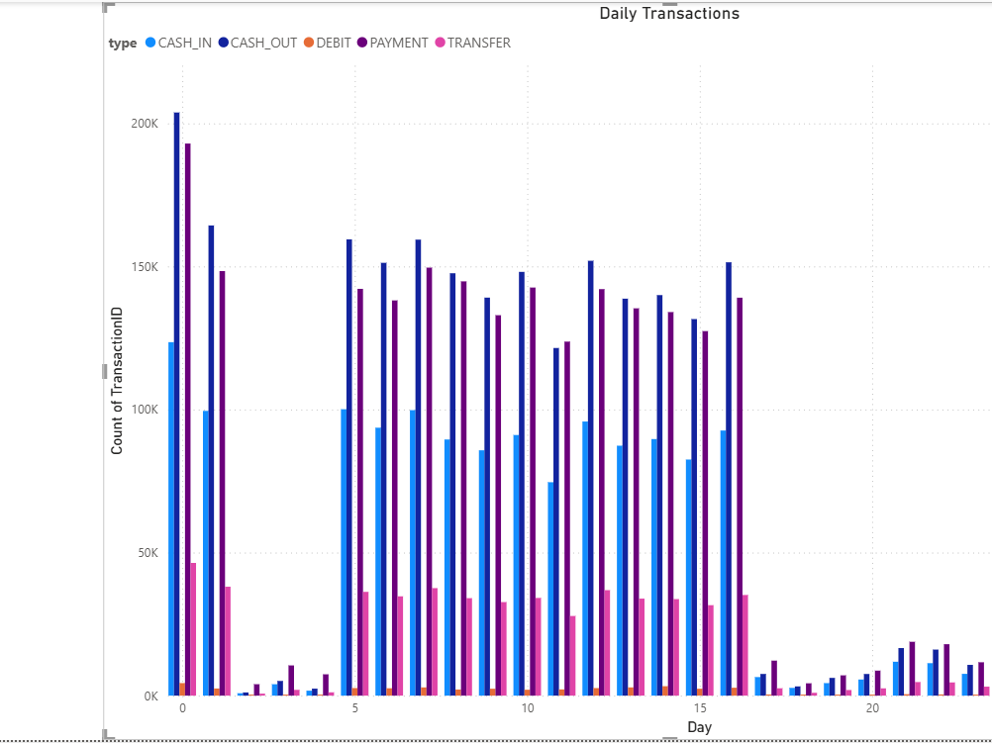
Fraud Trend Visuals
Charts show:
Hourly or daily spikes
Trends by transaction type
Anomalies in specific customer groups
Helps identify patterns over time.

Slide 30
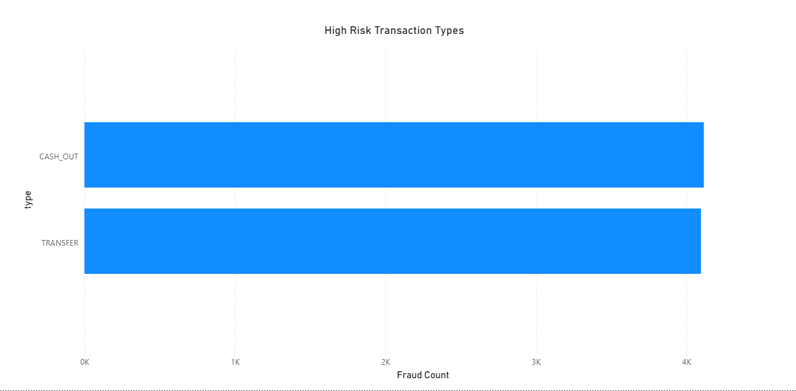
High-Risk Transaction Types
Visual highlights categories with highest fraud risk:
TRANSFER
CASH_OUT
Includes slicers to drill down by amount and account behavior.

Slide 31
Fraud Hotspots
Mapped and segmented views of:
High-risk accounts
High-value fraud events
Frequent suspicious transactions
Heatmaps surface concentrated problem areas.

Slide 32
User Segmentation
Power BI clusters users by:
Behavior
Volume
Risk level
Helps analysts focus on the most suspicious account groups.

Slide 33
Interactive Filters
Includes filters for:
Transaction type
Amount ranges
Time of day
Fraud status
Account segments
Enables targeted risk analysis.

Slide 34
Dashboard Insights Summary
Key insights identified:
Fraud is concentrated in a small subset of transaction types
Amount and balance patterns reveal strong fraud indicators
Sudden account depletion is a major red flag
Data supports early-warning fraud detection systems

Slide 35
Findings Summary
This project revealed that:
Fraud follows predictable behavioral patterns
Machine learning models can detect suspicious activity
BI dashboards help visualize risk in real time
Combining Python + Power BI strengthens fraud detection

Slide 36
Risk Insights
Notable fraud behaviors observed:
Rapid fund movement between multiple accounts
Large transfers followed by immediate cash-outs
Inconsistent balance behavior
High-frequency transactions from new accounts

Slide 37
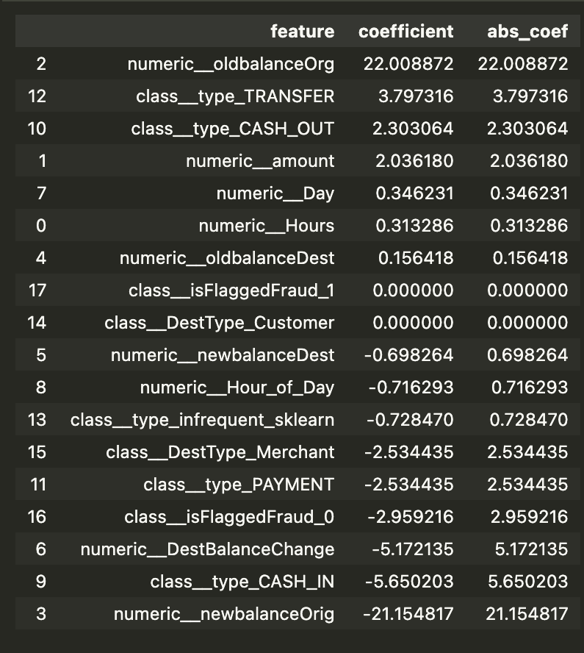
Python Analysis
Measures impact of Features on Fraud Likeliness
OldBalanceOrg has biggest impact on Fraud
Transfer and CashOuts most likely to be Fraud
Positive values improve Likeliness
Negative values make Fraud more unlikely

Slide 38
Business Implications
Organizations can use these insights to:
Strengthen fraud monitoring
Set up automated alerts
Prioritize high-risk account reviews
Improve compliance and auditing
Reduce financial losses

Slide 39
Recommendations
Implement ML-driven fraud scoring
Add real-time monitoring dashboards
Track account behavior over time
Use anomaly detection methods
Conduct periodic model tuning

Slide 40
Limitations
Synthetic dataset (not real customer data)
Models may overfit to dataset patterns
Limited external features (e.g., user demographics)
No real-time streaming or external validation

Slide 41
Future Work
Integrate real-world or multi-source datasets
Build a real-time detection system
Add graph-based analysis for account networks
Explore generative AI for fraud explanation

Slide 42
Conclusion
Python + Power BI together provide a strong BI framework for detecting fraudulent financial activity.
The project demonstrates how data analytics, BI modeling, and visualization work together to support proactive fraud prevention and strategic decision-making.

Slide 43
References
Kaggle PaySim dataset
IBM Fraud Detection Research
Microsoft Power BI Documentation
Scikit-learn docs
Financial fraud academic papers
Python EDA tutorials
(Insert full APA references)

Slide 44
Appendix Overview
Additional screenshots, visuals, and model outputs:
Python plots
Power BI model screenshots
Sample transactions
Cluster diagrams
Dashboard interactions

